Slide 1


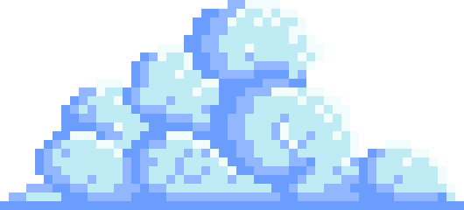
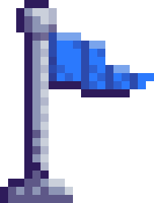
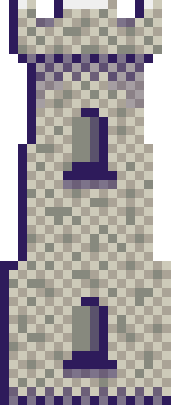
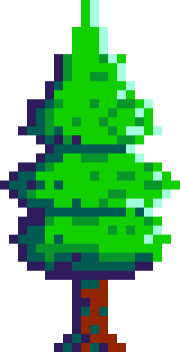
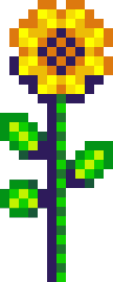
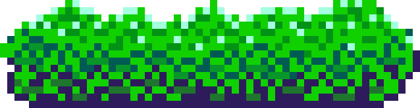

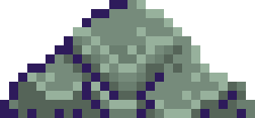
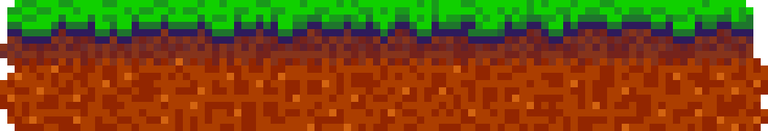
GRIMOIRE
OF THE
ANCIENTS

Slide 2
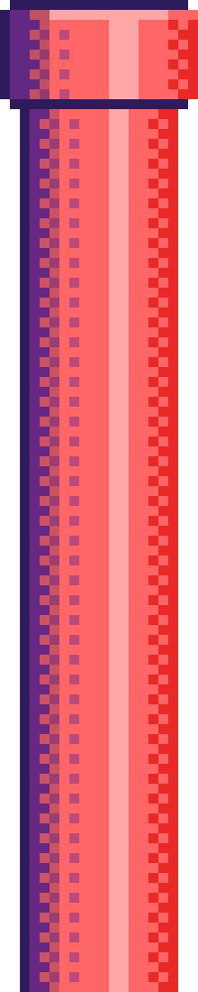
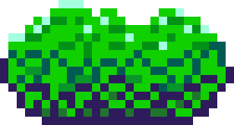
Summary
Grimoire of the Ancients is a 2D turn-based magical duel game where two players face off using curated spellbooks containing offensive, and utility spells. Each player will start with a fate decider to decide who will have the turn first to ensure fairness and a fixed amount of health. Each player sets a deck of spells before the battle begins such as lightning, fireball, heal and poison. Fireball and Lightning include unique passive effects that might increase the chance of winning. On each turn a player will select the spell from the spellbook to be cast on the opponent, except for utility spell. The duel continues until one player’s health reaches zero or the timer runs out.

Slide 3
Summary
The key to victory in this game lies in the player’s tactical choices and timing, such as managing health and selecting the right combination of spells for the duel. Smart decisions can create opportunities for comebacks and counterplay, even in losing situations. Each battle is a blend of planning, prediction, and strategy, enhanced by random match modifiers that can increase difficulty or shift the odds of winning. Players can also choose their wizard and progress through leveling, unlocking new characters as they advance. A profile system allows them to save and load their progress, set a custom username, and track their statistics.

Slide 4
Summary
  36 Classes and 5 Enums: Collaborate to coordinate logics and user interface.
  Dynamic systems: Random match modifiers every match, Spell’s passive chance probability.
  Multiple inheritances: Abstract spell with 6 child classes and Abstract effect with 4 child classes.
  Advanced battle mechanics: Multi-phase turns, Effect processing, Damage with and without modifiers, Scrollable battlelogs, Spell loadout.

Slide 5
Summary
  Data Management: Profile saving/loading with JSON, Dictionary-based sprite storage, Spell effect stacking and duration tracking
  Real-time system synchronization: Battle logic, Wizards animation, Audio, Particle, UI all synchronized.
  Multi-screen UI: Menu, Wizard select, Loadout, Battle, End.
  Level system: Allows player to unlock wizards according to level

Slide 6
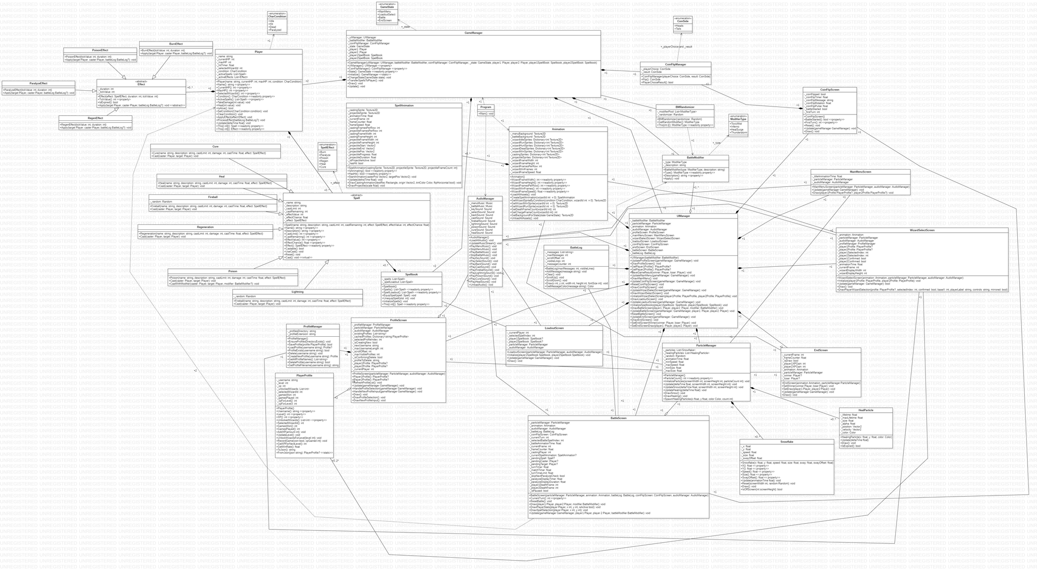
CLASS DIAGRAM

Slide 7
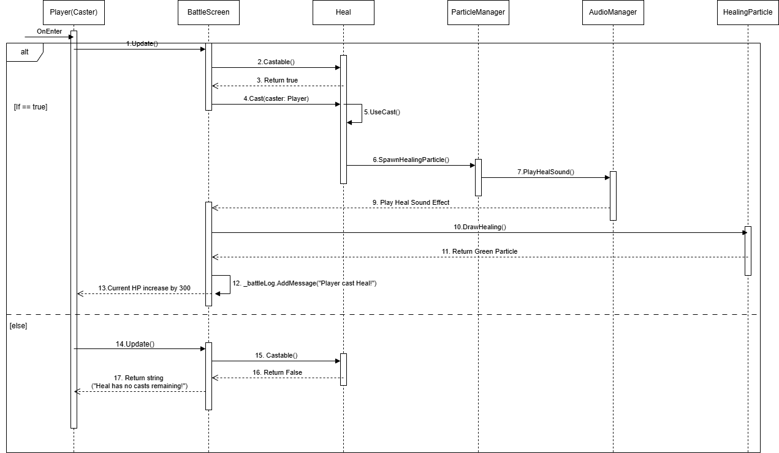
SEQUENCE DIAGRAM

Slide 8

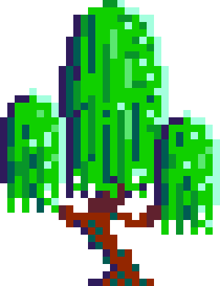
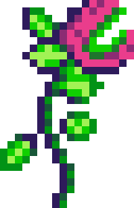
THANK
YOU

